Slide 1



Slide 2
Why was FocalPoint created?
To answer the needs of large scale collaborative editing.
Originally started out as a project management tool for BBC SPORTS. Projects could be lost, incorrectly named etc.
50 seats of Final Cut Pro 7 coping with busy sporting summer of 2012.
Platform Hell.
Versioning Hell – creating and tracking.
200-300 constantly changing personnel.
Design Brief; must be simple for the user!
Notes:
Platforms BBC Sports uses; iPad, iPhone, Android, Web site and on-to-air versions

Slide 3
Pain Relief
Enforces correct file naming through drop down menus, and correct save location through projects. Very few freeform text input fields.

Slide 4
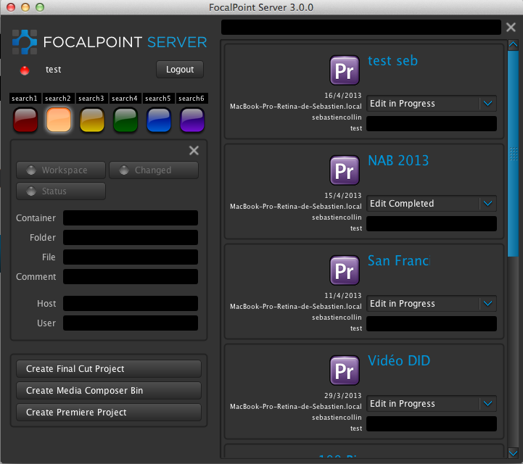
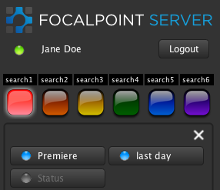
Pain Relief
Simple interface.
5-10 minutes training.
Notes:
This is an adobe workflow.

Slide 5
Pain Relief
Easy search with search light buttons. The document finds you in three clicks.
All the complex work is behind the scenes.
FocalPoint Server automatically sets up and maintains the necessary file or folder structures for:
Major NLEs, e.g. Final Cut Pro, Avid, Premiere
VFX packages, e.g. After Effects, Maya
Graphics packages, e.g. Photoshop, Illustrator
Notes:
Platforms BBC Sport use; iPad, IPhone, Android, Web site and on-to-air versions.
FocalPoint Server hides the complexity from the end user and deals with it in a centralized and coherent manner, by modeling the requirements and workflow of the organization as meta-data objects called schemas, workspaces and tags. FocalPoint Server thinks the way editors think. Projects and bins are the central containers for media, logging information and data, including sequences and markers. This abundance of information is held in FocalPoint’s database built on mongodb (think Craigs List).

Slide 6
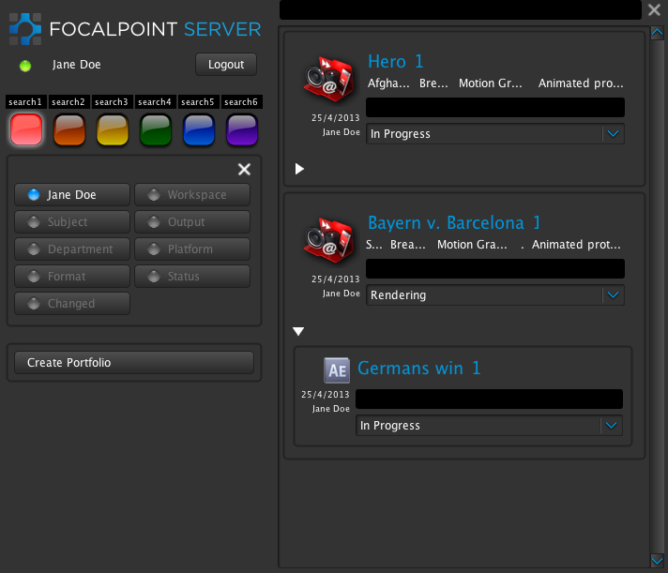
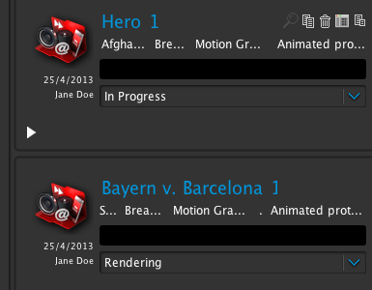
Pain Relief
Versioning and tracking: Simple buttons for the user which create directory and file structures behind the scenes
Status notifications make communications instant, and workflows are efficient.

Slide 7
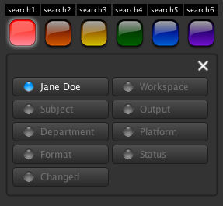
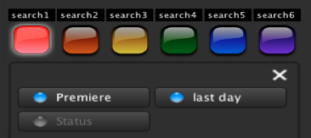
Reliable – High Availability, fails over to another server
Resilient – automatically backs up all your projects to another server. Splits searches over multiple servers.
Completely customizable including hierarchy of roles, search buttons, NLE/Graphics/Specialized workflows and more.
Notes:
Unlimited number of users – scales up easily. Buttons, titles, number of traffic light search buttons etc all customizable. Schemas are easily customizable, Graphics workflow, NLEs, VFX or a mix of all three is easily possible. Licenses and pricing are based on concurrent users and number of applications or workspaces.

Slide 8
FocalPoint Server‘s simple, yet powerful API enables integration with third party applications such as Content Agent.
…So you can drag and drop any file format into your FocalPoint Project and it will automatically convert to your preset mezzanine format
Notes:
Content Agent is integrated with FocalPoint Server.

Slide 9
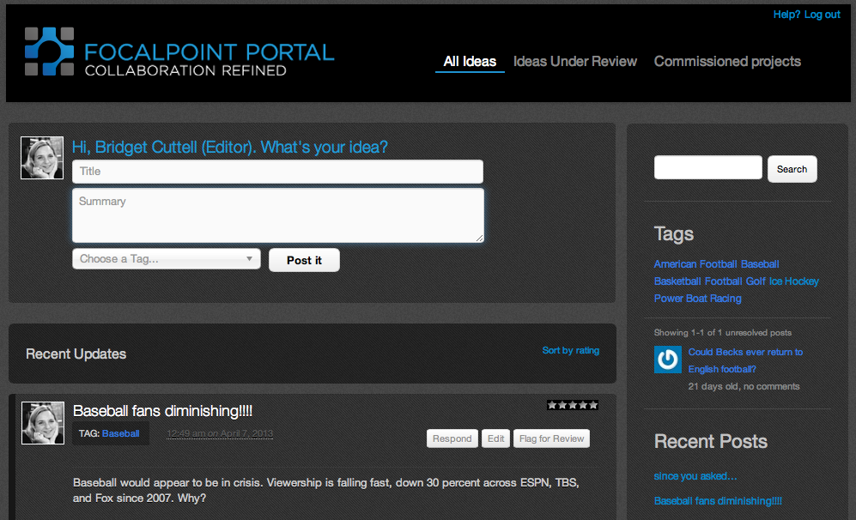
FocalPoint Portal
Pool your ideas
-Propose ideas for the day’s stories by starting a conversation in the FocalPortal (like Facebook or Twitter).
Discussion
-Comment on each other’s ideas and add media or articles.
Notes:
Extra module. A new social media-like collaboration tool to bridge the gulf between production and post-production. Take your project from conception to archive in one fluid system, using the editing tools you already own. Linked to FocalPoint Server by SOAP API

Slide 10
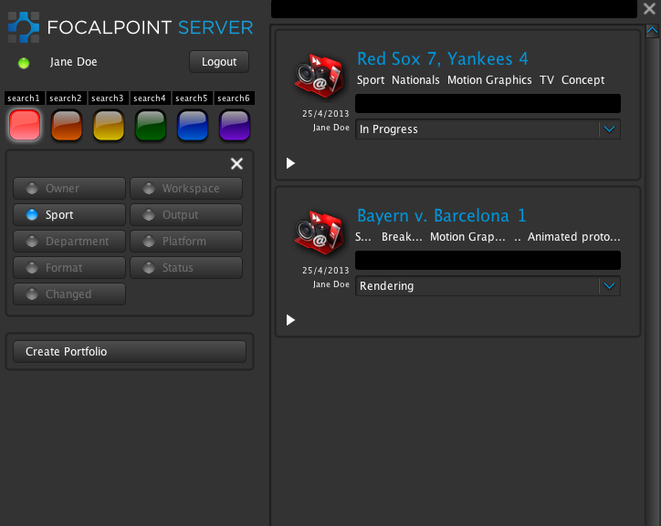
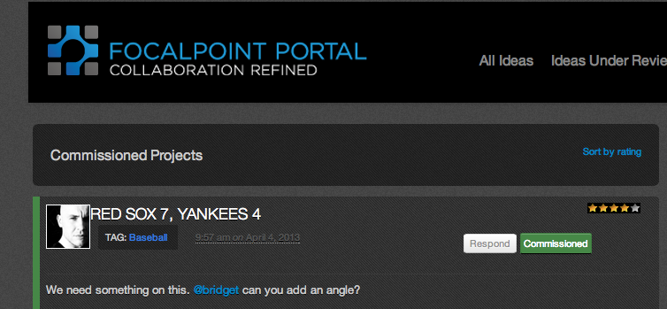
FocalPoint Portal
Commission
-The commissioning editor reviews the ideas and can commission them.
Just Create
-The commissioned project becomes a Project Portfolio in FocalPoint Server.

Slide 11


FocalPoint Archive
When the project is finished, it can be archived from FocalPoint Server. We have built an engine that links to all major archiving and storage systems, such as Archiware, Atempo, Cache-A, Space, Quantum and SAN Fusion. Reporting can track the various stages of the workflow so you know the exact status of the project.

Slide 12
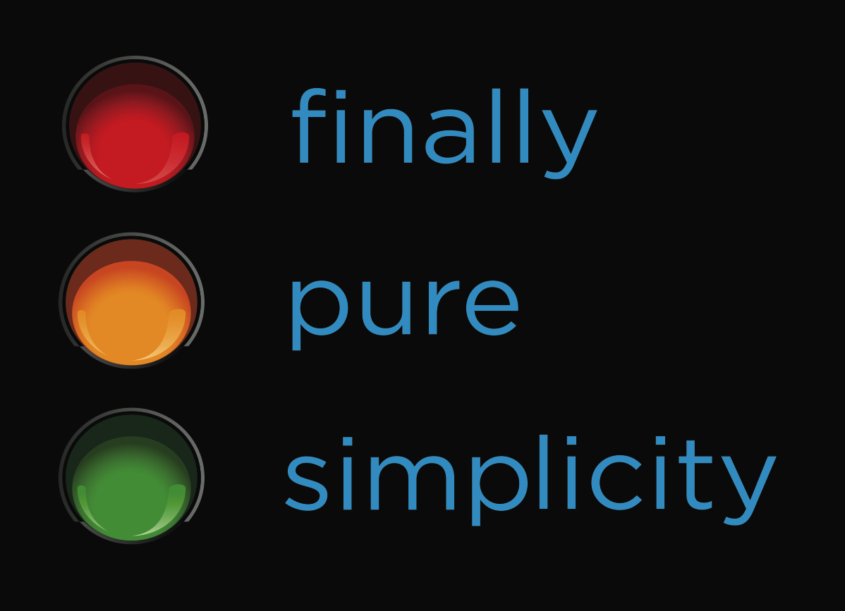
Finally Pure Simplicity
FocalPoint Server, FocalPortal, and FocalPoint API bridge the gulf between production and post production.
Take an idea from conception to archive in one simple to use system. The technology behind the scenes manages the complexity so you don’t have to.

