Slide 1


Sales Training

Slide 2
Content
Managed Collaboration?
FocalPoint Server benefits
What is FocalPoint Server?
The modules
Functionality of FocalPoint Server
Example workflow / Case Study
FocalPoint Server and CatDV
Technical Support Channels
FocalPoint Server Pricing
Q & A

Slide 3
Managed Collaboration
SAN is not enough – searching is costing time and money
Creative Professionals search for media on average 83 times a week
… and FAILS to find it 35% of the time with no DAM!
1 in 10 hours on average is spent on file management
Source; Gistics.com

Slide 4
Collaboration between Editors?
Multiple studio locations?
Saving files in the wrong place?
Wrong name?
Don’t know what version to work on?
No time for training?
Can’t log? Won’t log? Don’t log?
Use NLEs and/or Graphics and/or VFX in one workflow?
Rationale for PAM?

Slide 5
Benefits
FEATURES Search | BENEFITS Your projects are never lost
Data management | IT & Production can now do their jobs
Project Tracking | Filtering - fast
Compliance | Managing Company Risk
Data Security | Protect accidental deletion
User Interface | Minimal Training time
Deployment | Point & Click
Quality Assurance | Maintaining company standards
Automation | Higher Productivity

Slide 6
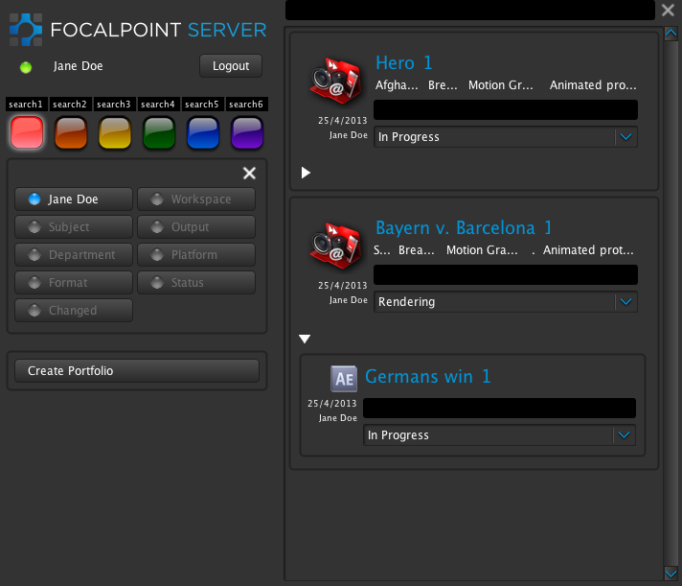
It is a visually simply interface designed to take away workflow complexity and empower users to create and managers to manage.
What is FocalPoint Server?

Slide 7
The Modules
FocalPortal
FocalPoint Server
FocalPoint Archiving

Slide 8
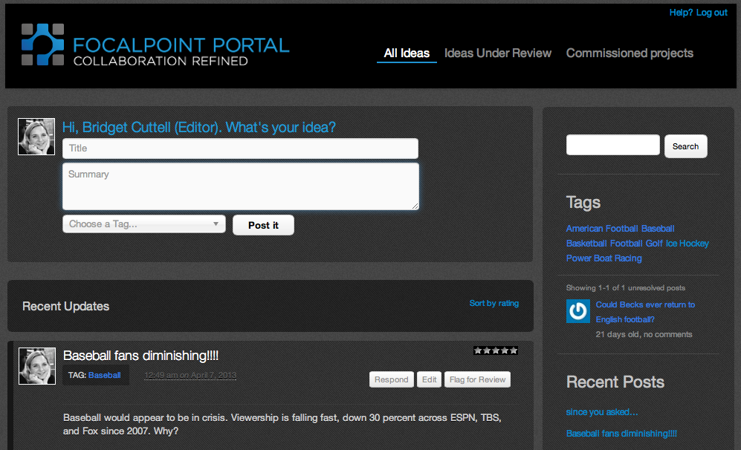
FocalPoint Portal
Portal
Pool your ideas
-Propose ideas for the day’s stories by starting a conversation in the FocalPortal (like Facebook or Twitter).
Discussion
-Comment on each other’s ideas and add media or articles.
Notes:
Extra module. A new social media-like collaboration tool to bridge the gulf between production and post-production. Take your project from conception to archive in one fluid system, using the editing tools you already own. Linked to FocalPoint Server by SOAP API

Slide 9
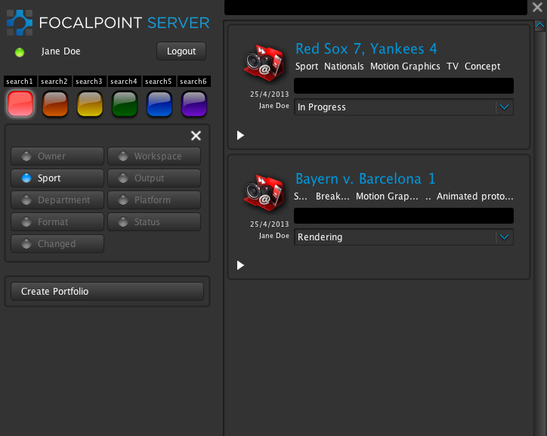
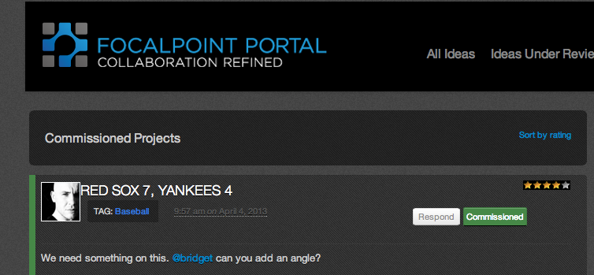
FocalPoint Portal
Commission
-The commissioning editor reviews the ideas and can commission them.
Just Create
-The commissioned project becomes a Project Portfolio in FocalPoint Server.

Slide 10
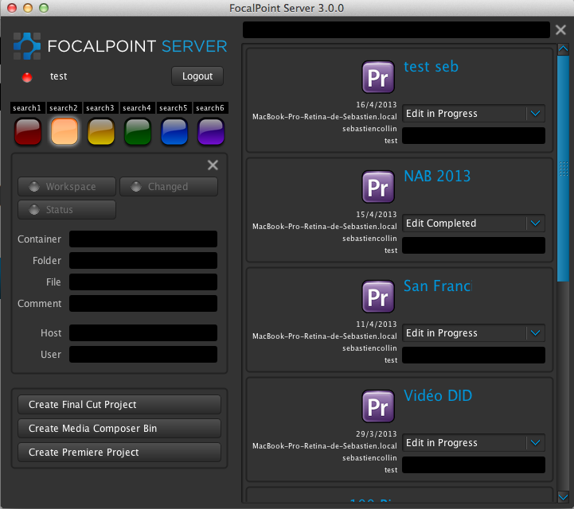
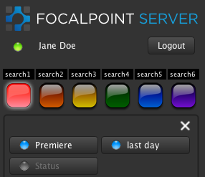
FocalPoint Server
Simple interface.
5-10 minutes training.
Notes:
This is an adobe workflow.

Slide 11
File Naming
Enforces correct file naming through drop down menus, and correct save location through projects. Very few freeform text input fields.

Slide 12
Search
Easy search with search light buttons. The document finds you in three clicks.
All the complex work is behind the scenes.
FocalPoint Server automatically sets up and maintains the necessary file or folder structures for:
Major NLEs, e.g. Final Cut Pro, Avid, Premiere
VFX packages, e.g. After Effects, Maya
Graphics packages, e.g. Photoshop, Illustrator
Notes:
Platforms BBC Sport use; iPad, IPhone, Android, Web site and on-to-air versions.
FocalPoint Server hides the complexity from the end user and deals with it in a centralized and coherent manner, by modeling the requirements and workflow of the organization as meta-data objects called schemas, workspaces and tags. FocalPoint Server thinks the way editors think. Projects and bins are the central containers for media, logging information and data, including sequences and markers. This abundance of information is held in FocalPoint’s database built on mongodb (think Craigs List).

Slide 13
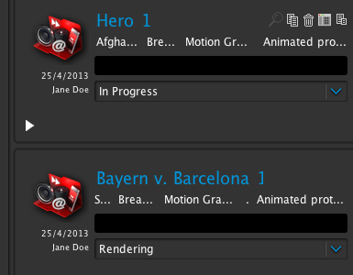
Versioning
Versioning and tracking: Simple buttons for the user which create directory and file structures behind the scenes
Status notifications make communications instant, and workflows are efficient.

Slide 14
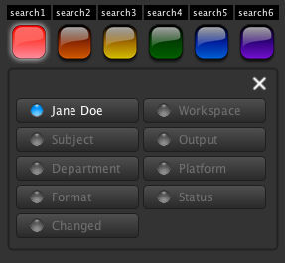
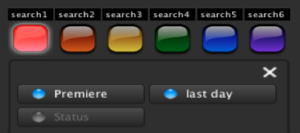
Configuration
Reliable – High Availability, fails over to another server
Resilient – automatically backs up all your projects to another server. Splits searches over multiple servers.
Completely customizable including hierarchy of roles, search buttons, NLE/Graphics/Specialized workflows and more.
Notes:
Unlimited number of users – scales up easily. Buttons, titles, number of traffic light search buttons etc all customizable. Schemas are easily customizable, Graphics workflow, NLEs, VFX or a mix of all three is easily possible. Licenses and pricing are based on concurrent users and number of applications or workspaces.

Slide 15


FocalPoint Archive
When the project is finished, it can be archived from FocalPoint Server. We have built an engine that links to all major archiving and storage systems, such as Archiware, Atempo, Cache-A, Space, Quantum and SAN Fusion. Reporting can track the various stages of the workflow so you know the exact status of the project.

Slide 16
Case Study - BBC Sport
Originally started out as a project management tool for BBC SPORTS. Projects could be lost, incorrectly named, stored in the wrong location, latest version etc
50 seats of Final Cut Pro 7 coping with busy sporting summer of 2012.
Platform Nightmare - iPad, iPhone, Android, Web site and on-to-air versions
Versioning Nightmare – creating and tracking.
200-300 constantly changing personnel.
“FocalPoint Server solved a circuital workflow and productivity issue for us during one of our busiest and highest profile periods of broadcasting on record. It was reliable, easy to use and it did the job asked of it.” Post Production Lead at BBC Sport.

Slide 17
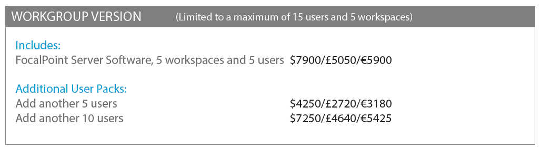
Pricing
Workgroup Version for up to 15 users

Slide 18
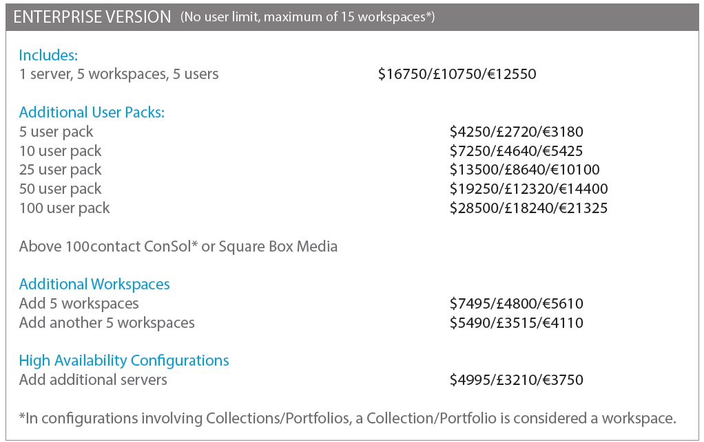
Pricing

Slide 19
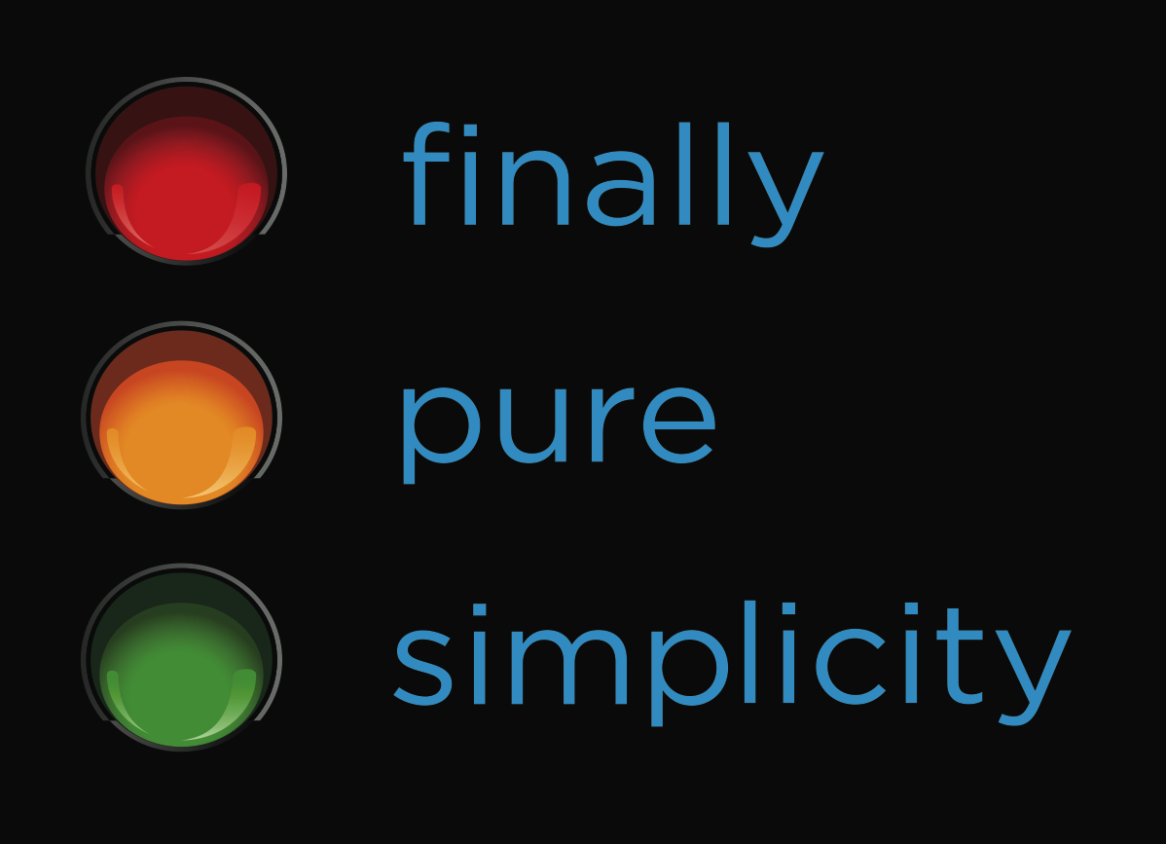
Managing Risk
Increase workflow efficiencies
Empower users
IT & Production doing ‘real stuff’
ROI
Q & A
Take away workflow complexity and empower users to create

