Slide 1
Basics on how to CONFIGURE FocalPoint Server’s administrative interface

Slide 2
The Users tab = Each User is attributed one or more ‘Roles’

Slide 3
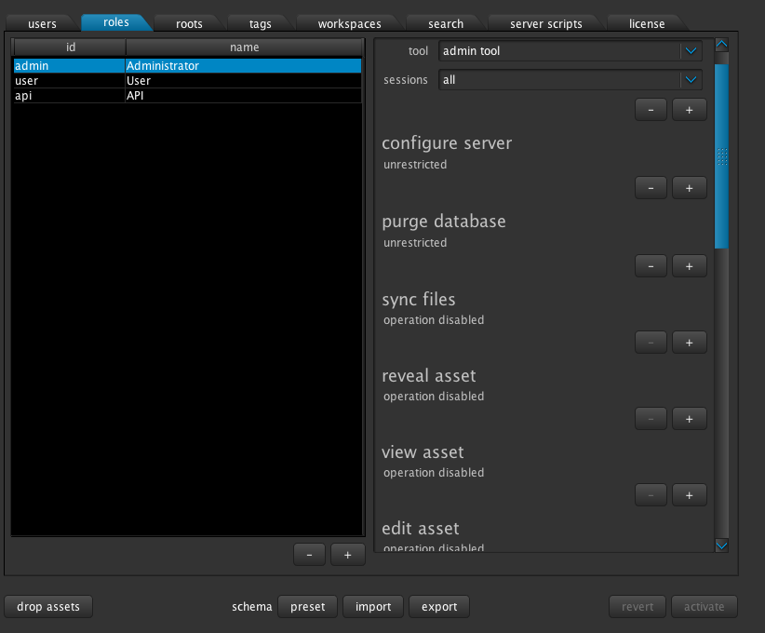
The Roles Tab = your capabilities
Users and Admin and Api users have different capabilities.

Slide 4
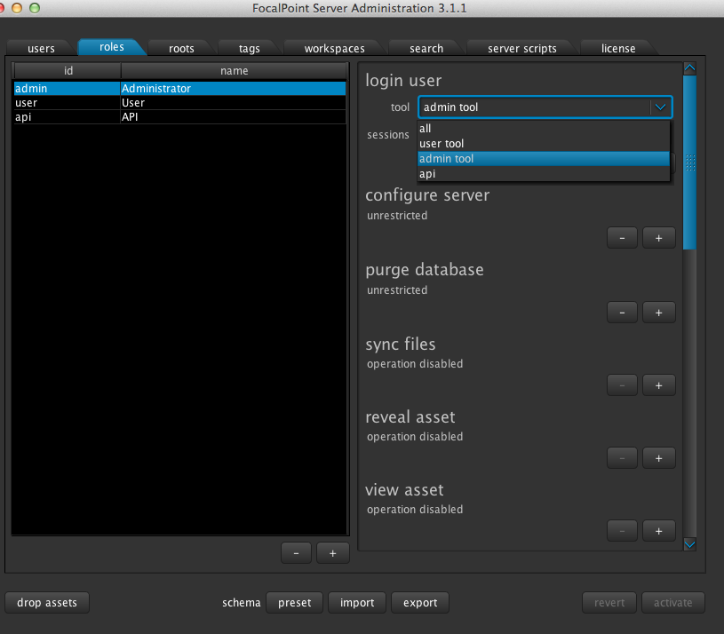
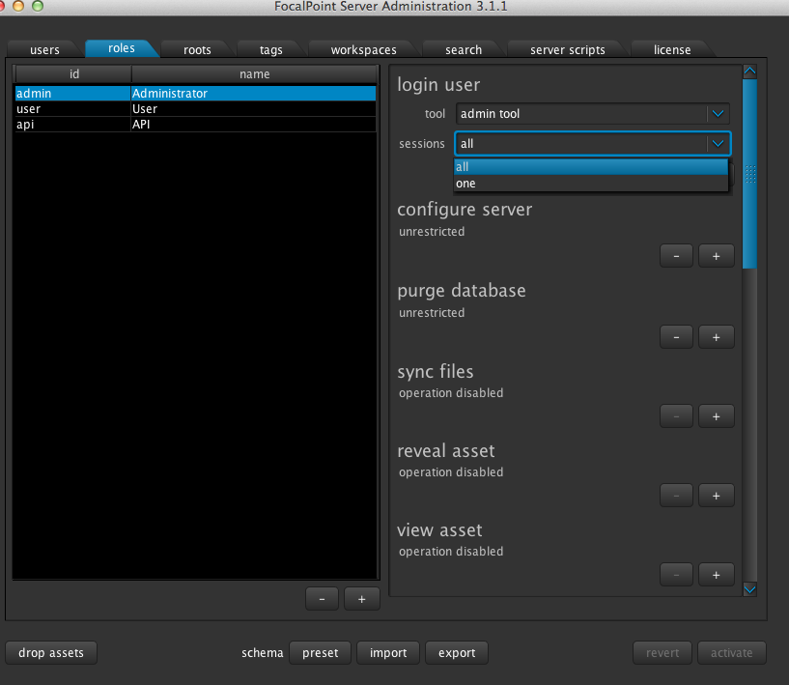
Tools = Where you have access to; The admin back end GUI, client front end GUI or API Information.
E.G
role administrator, people who can log in into the admin GUI only
User Bridget, who is an administrator and a user so she can manage the server and edit
Sessions = How many logins per user.
“One" if you don't want the same user to login from different computers.

Slide 5
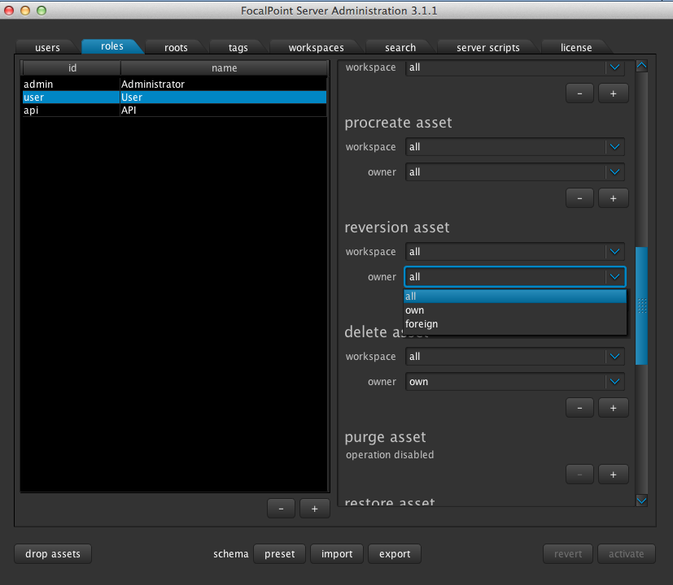
Further down within Roles; which actions a user is allowed to perform, such as ‘Create a new version’ etc
Here all users can reversion. It could be that users could only reversion their own projects, or only projects from other users.

Slide 6
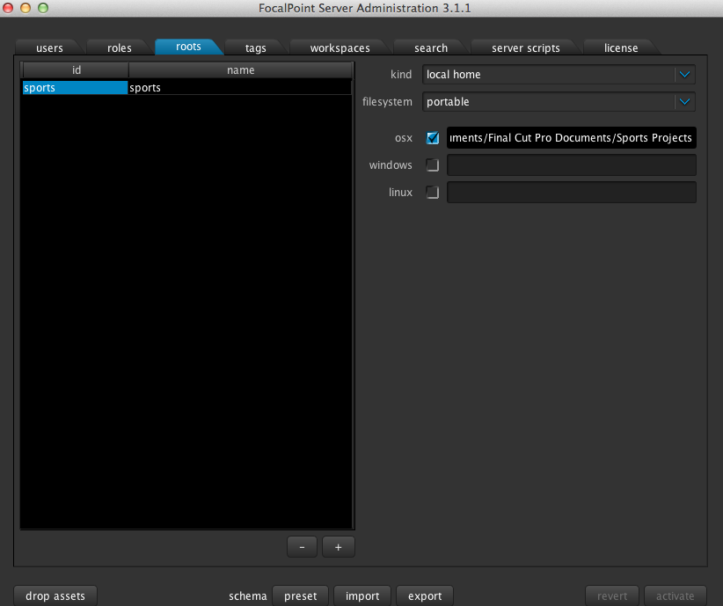
Roots Tab = Your path to where projects are saved, demonstrated by ‘Reveal’ button.

Slide 7
In order to later create a Portfolio or add a new application, you will need to add another Root here
In every tab, add a new line with the + button

Slide 8
A Portfolio will have a container: Root As well as the collection box ticked.

Slide 9
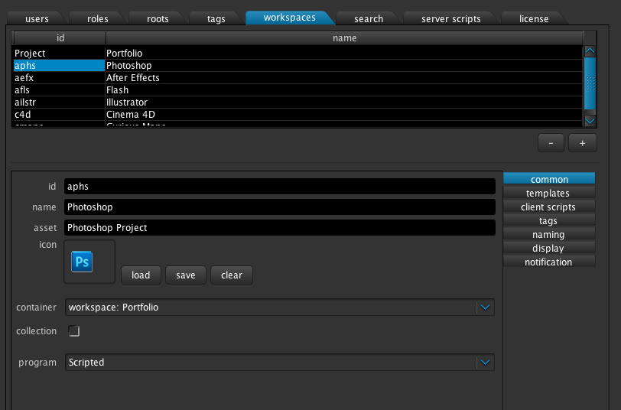
An application will have a container: Workspace
This will set the application within your portfolio, so that you have one ‘Create Portfolio’ button and each application is available with the ‘Create Child’ button on each created Portfolio.

Slide 10
Tags Tab = Your schema. This list is a pool of tags you will use throughout FocalPoint Server

Slide 11
Workspaces = Your applications as well as any Portfolios

Slide 12
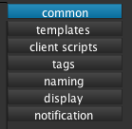
Each workspace has individual settings. Portfolios differ from applications.
Common = logo and name of application etc
Templates = this opens with the launch of the application
Client scripts = customisable scripting important for portfolios having drag and drop functions
Tags = What the user is asked to provide, on creation of a file. As well as what remains editable throughout workflow
Naming = On creation of a project, dictates how the filename will be arranged
Display = How the project appears on the right hand side.
Notification = layout of growl notifications appearing with a change of status/creation of project etc

Slide 13
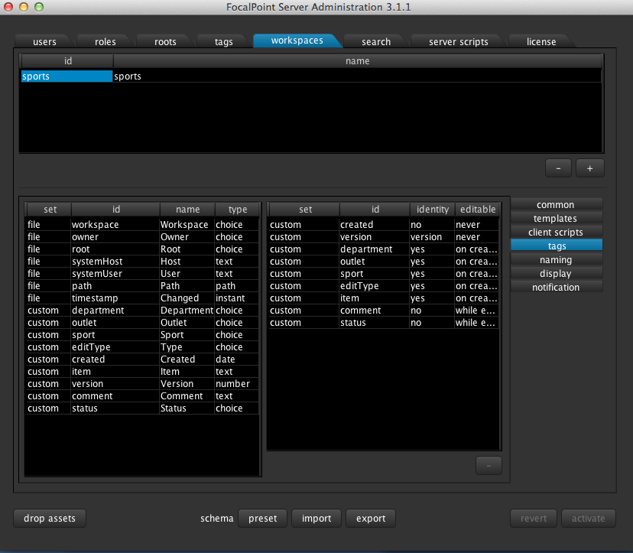
Workspaces/Tags = What the user is asked to provide, on creation of a file. As well as what remains editable throughout workflow

Slide 14
Workspaces/Naming = On creation of a project, dictates how the filename will be constructed

Slide 15
Workspaces/Display = How the project appears on the right hand side.

Slide 16
Search Tab = set your ‘grid’ search filter buttons

Slide 17
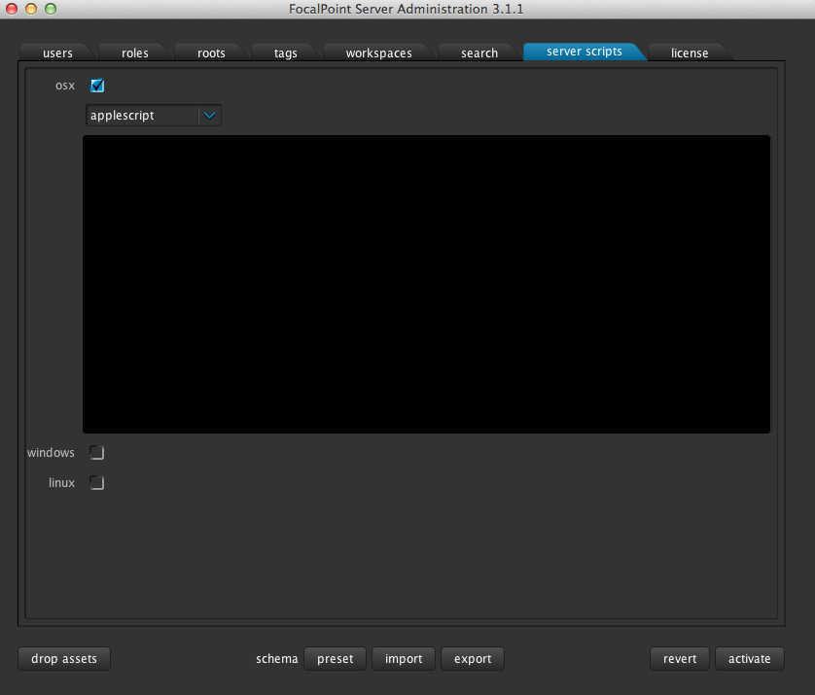
Server scripts = extra scripting to be commissioned from us or local coder

Slide 18
License = send us the request and the response will be your personal license for the duration

